Slide 1


Social Buzz

Slide 2


Agenda
Project Recap
Problem
The Analytics team
Process
Insights
Summary

Slide 3

Social Buzz is a social media conglomerate that focuses on creating new platforms where content took the center stage.
An audit of Social Buzz’s big data practice
Recommendations for a successful IPO
Analysis to find Social Buzz’s Top most popular categories of content.
Project Recap

Slide 4

Problem
Over 100000 posts per day
36,500,00 pieces of content per year!
Which categories are viewed a lot by customers?
How to capitalize on it when there is so much?

Slide 5


Andrew Fleming (Chief Technical Architect)
The Analytics team
Marcus Rompton (Senior Principle)
Mary Eyeson (Data Analyst)

Slide 6
Data understanding Collect the data and extracted the needed information
Process
1
2
Data cleaning by removing duplicates and information relevant to the problem
3
Data Modeling: joining relevant columns using Vlookup, Xlookup formula
4
Data Analysis: Creating visualizations such as bar chart, line chart to identify the top 5 categories.
5
Present the findings and visuals.

Slide 7
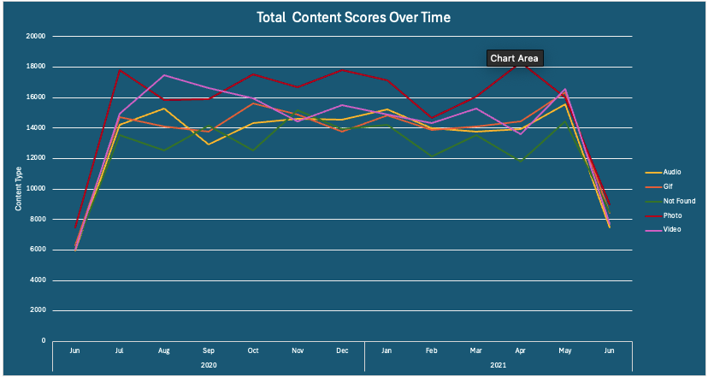
Insights

Slide 8
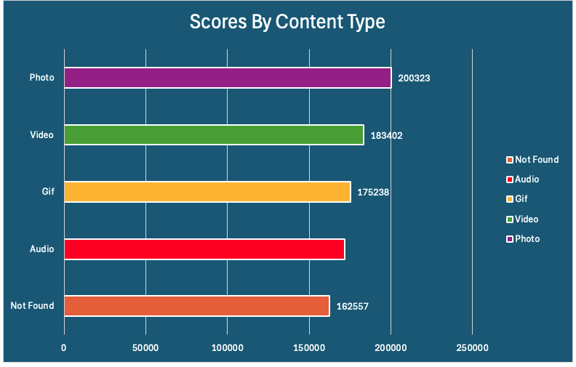
Insights

Slide 9
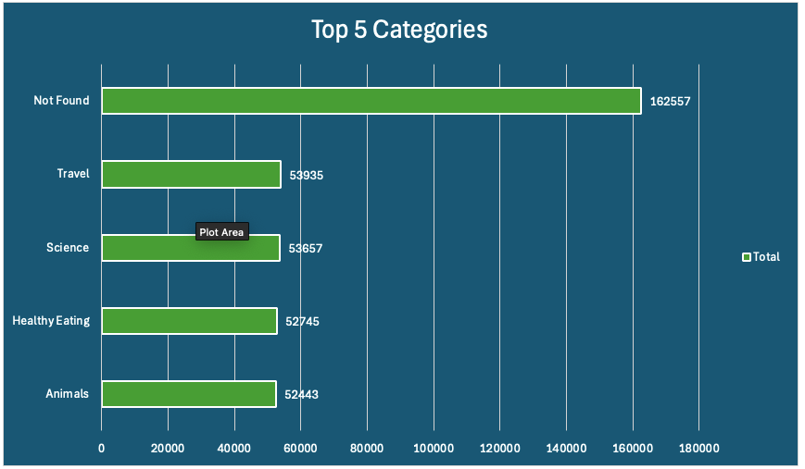
Insights

Slide 10


Summary

Slide 11

Thank you!
ANY QUESTIONS?

